Slide 1
Why did we choose ITQ in Denmark
To solve the big trawler´s economic problems
by creating a new mortgage security for those boat owners who needed more quota
to strengthen their investments in capital demanding large scale advantages
This was the succes: an irreversible proces increasing the concentration of quotas on a few large trawlers and purseseiners

Slide 3
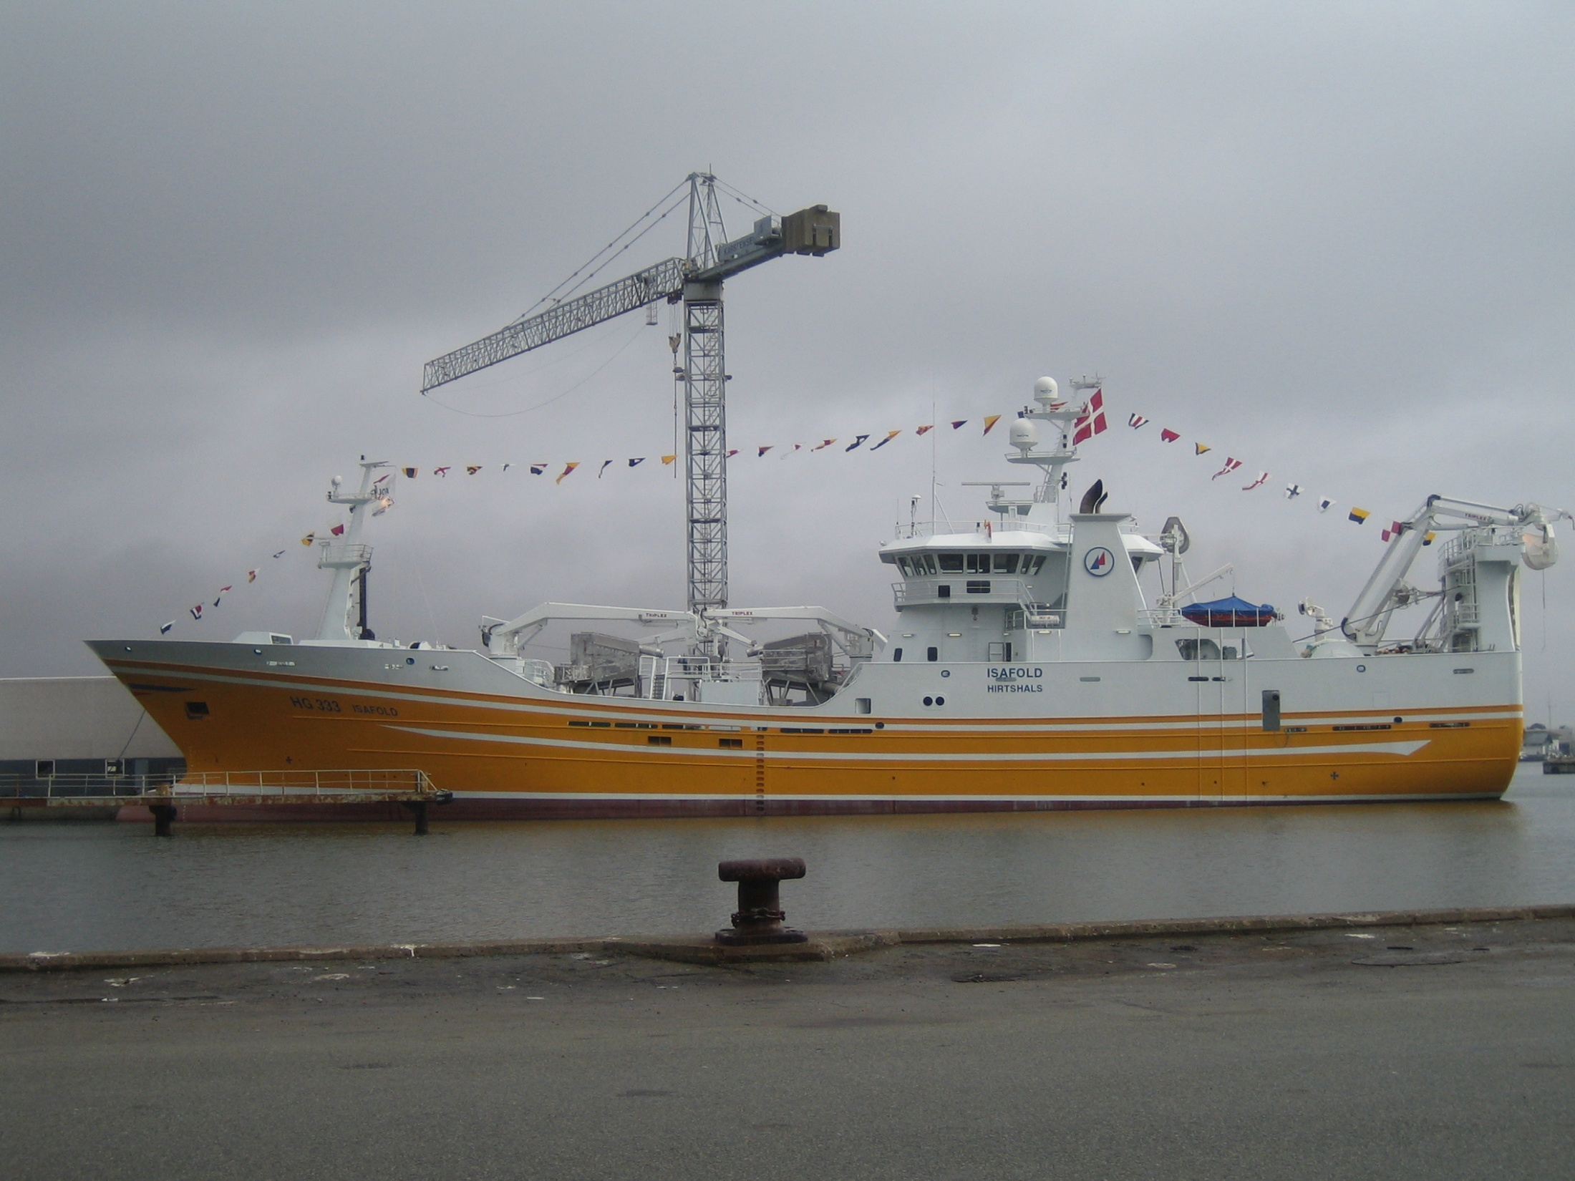

Slide 4
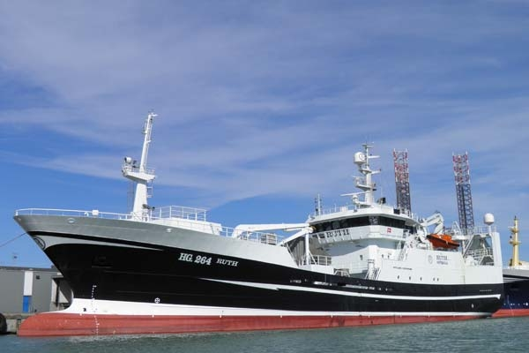

Slide 5
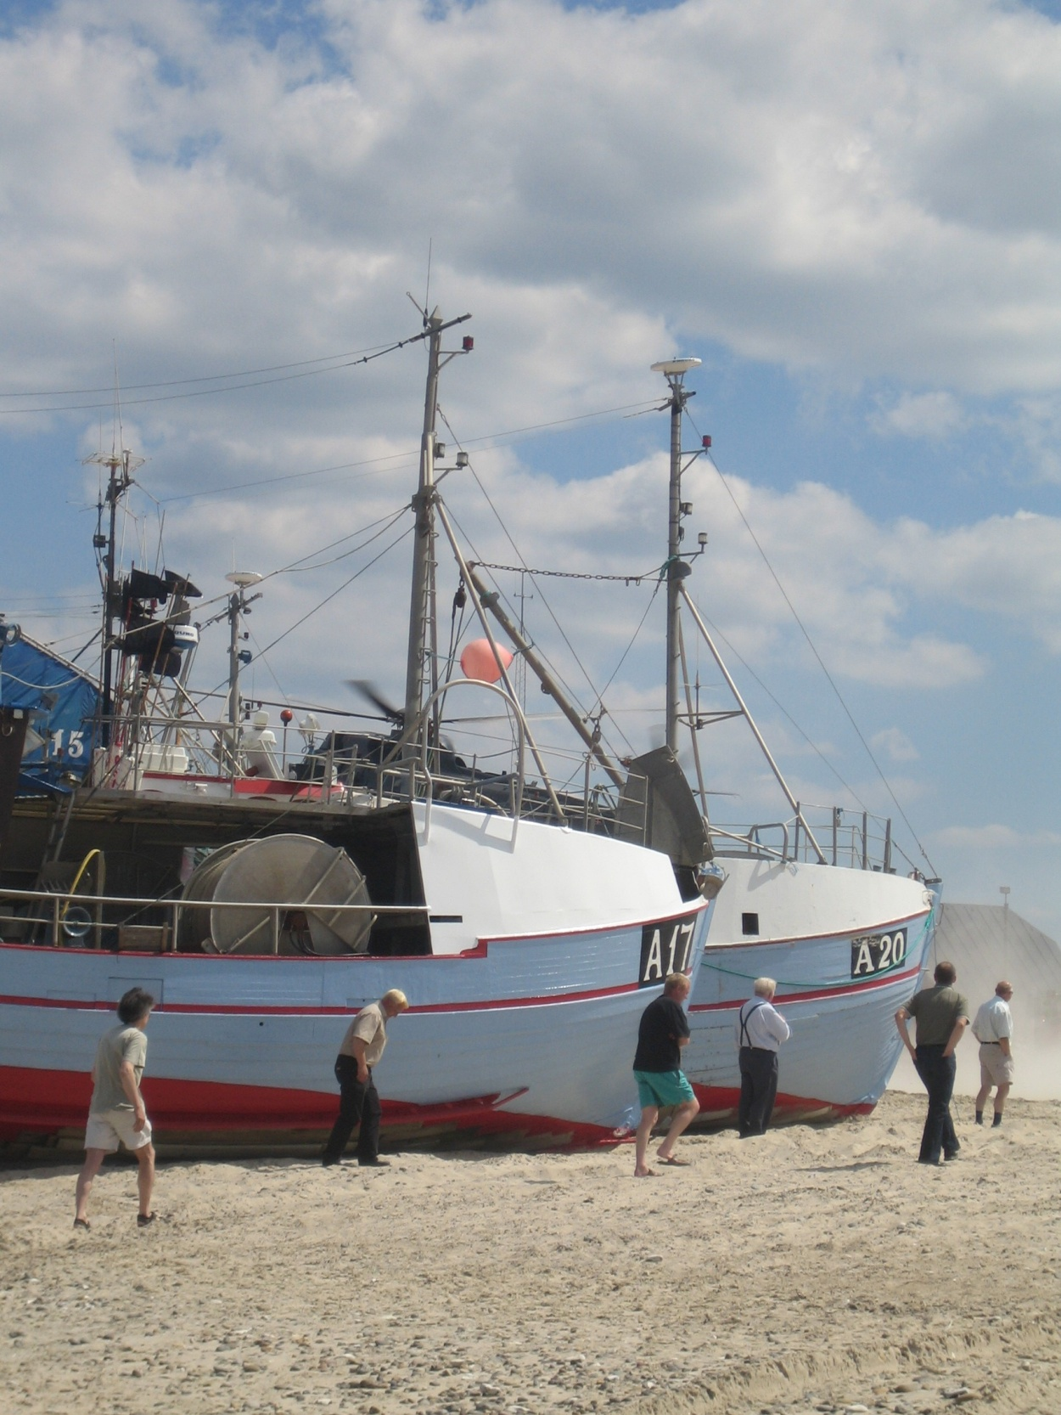

Slide 6
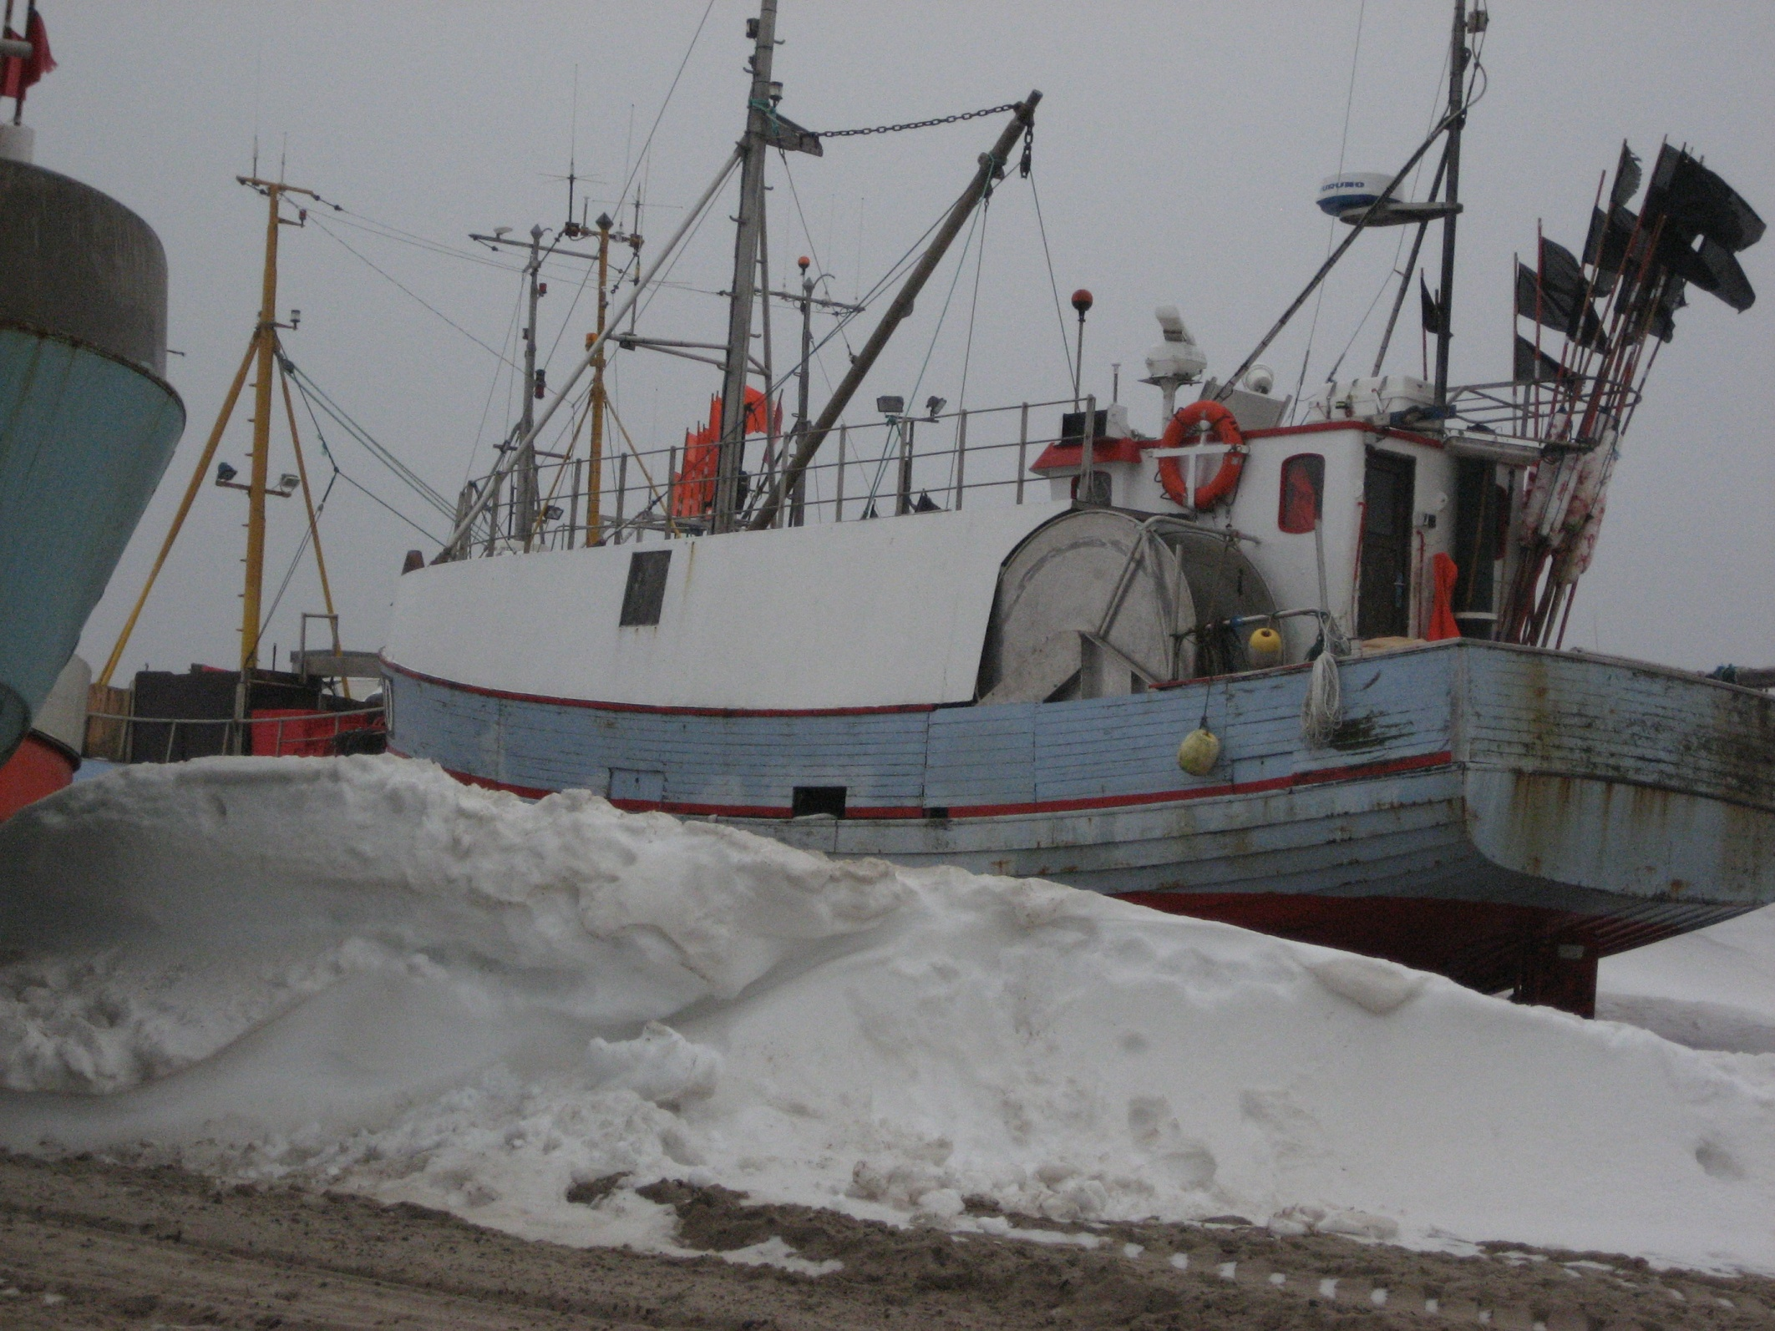

Slide 7
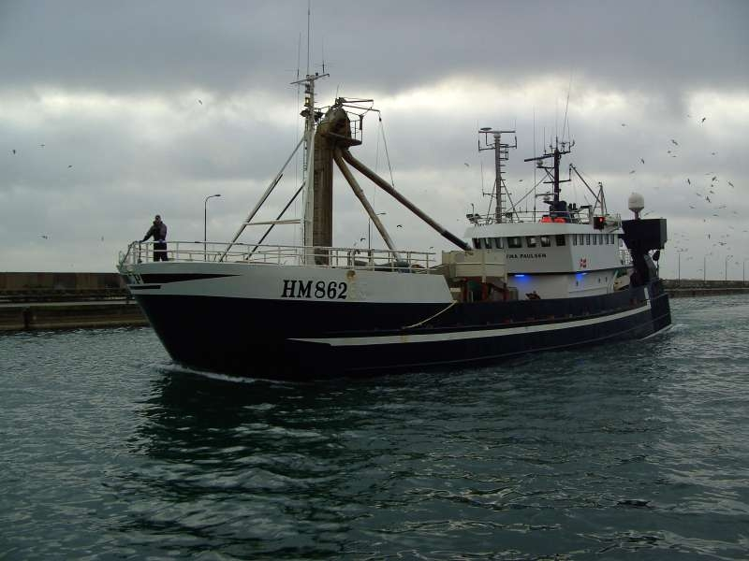

Slide 8
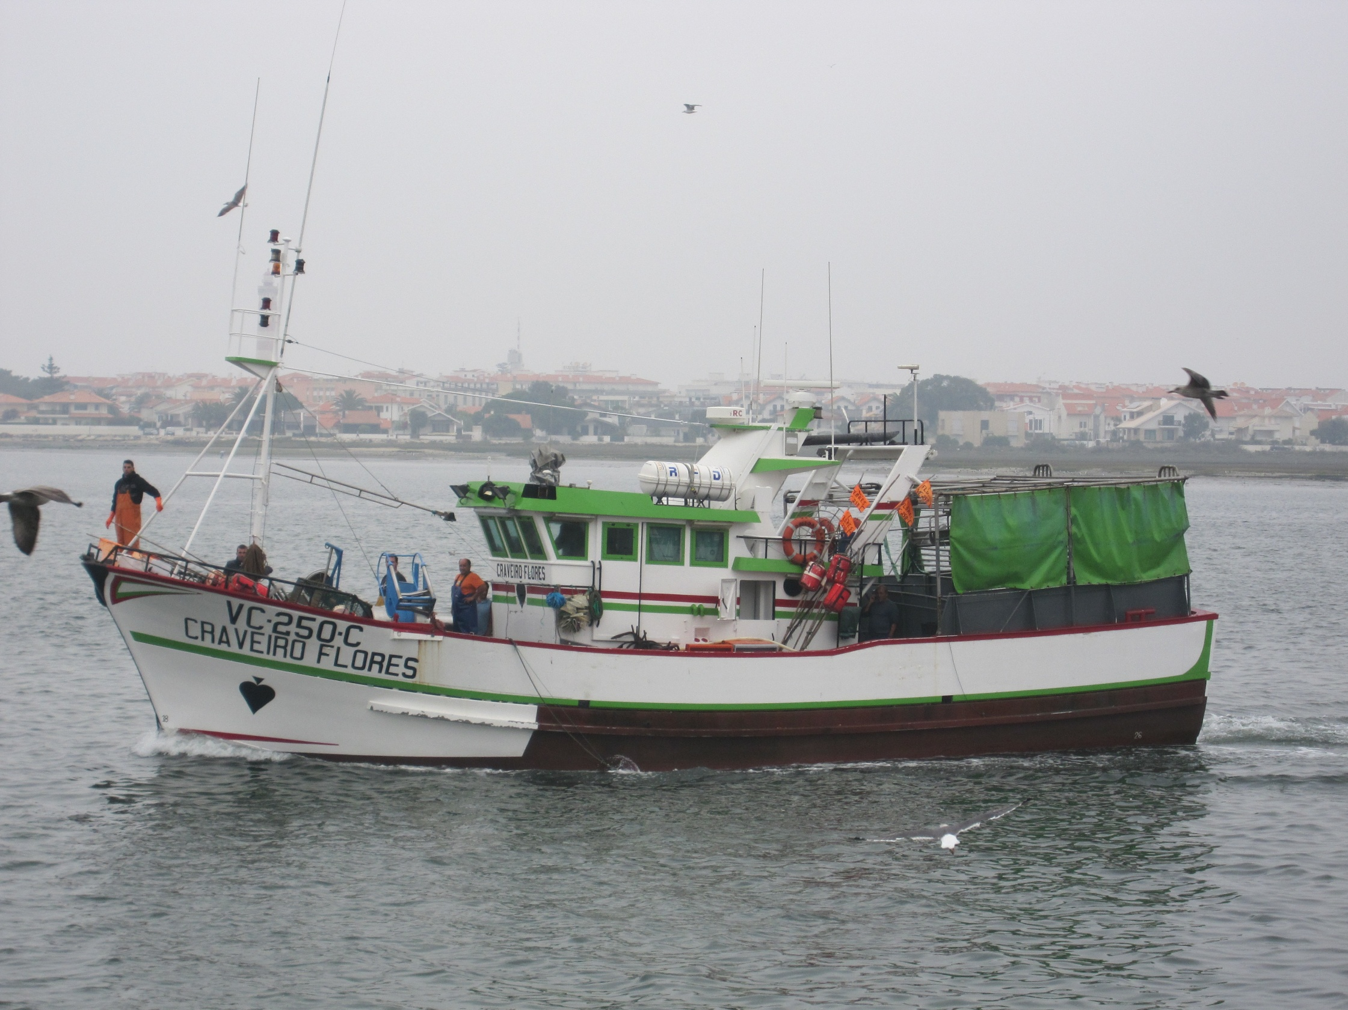

Slide 9
