Slide 1
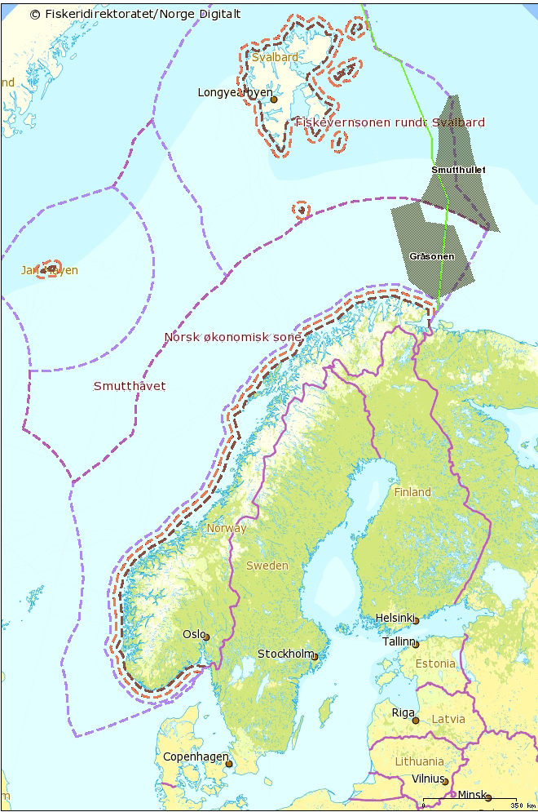
The Norwegian experience with a TFC-like system
(Structural Quota System)
Fish for the Future
Transferable fishing Concessions - the solution to overfishing or a problem in itself?
Brussels, 6. December 2011
Per Sandberg
The Norwegian Directorate of Fisheries

Slide 2
Subsidies to Norwegian Fisheries (1962-2010)
Source: Norwegian Seafood Export Council

Slide 3
Vessels scrapped during the period 1960 - 2002

Slide 4
Norwegian catch, fishermen and their efficiency during the period 1945 - 2010
* Preliminary figures

Slide 5
Objectives and target fleets for TFC-like instruments
Objectives
A fleet size more in balance with sustainable yields from fish stocks
A diversified fleet, being able to harvest in various parts of the ocean
A fleet that provides activity along the various municipalities along the coast
Target fleets
Multiple fleets of ocean-going vessels holding a license to fish
Coastal vessels holding annual license to fish
Non-target fleets
Small-scale, coastal vessels

Slide 6
Instruments and safeguards
Instruments
Stability in quota allocation
Duration of TFC in adequate period
Safeguards
Avoid concentration of quotas in geographical areas
Avoid concentration of quotas on fleets
Avoid concentration of quotas on individual owners

Slide 7
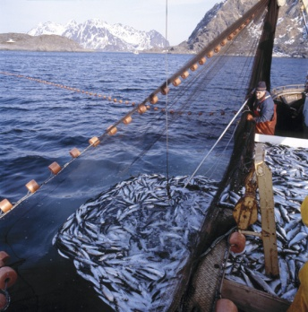
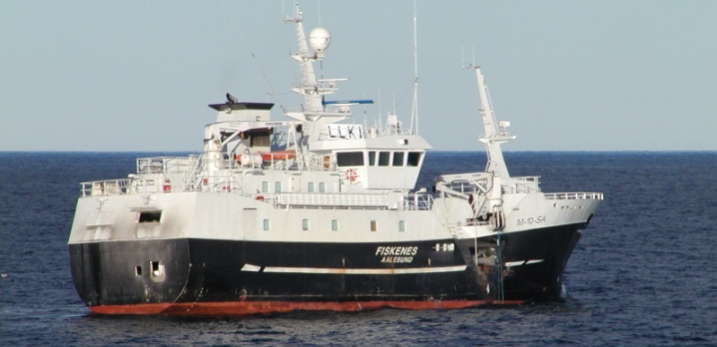
Current Instruments
Management instruments to regulate the fisheries
Management instruments to adjust harvest capacity
Input
Output
Denomination
Number of vessels*
Licences/
Annual permits
IVQ**
Buy-back programs
SQS***
(TFC-like system)
Ocean-going vessels
259
X
X
X
Coastal vessels; 11-28m
963
X
X
X
Coastal vessels; 0-11m
1231
X
X
(Finished)
* 1. December 2011
** Individual Vessel Quotas
***Structural Quota System

Slide 8
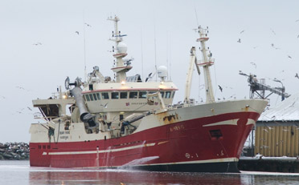
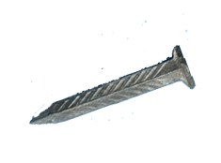
Structural Quota System – Offshore Fleet
Structural quota; 20 years duration
Only for vessels holding a valid license
One vessel must be scrapped
Quota
100%
+

Slide 9
Have the TFC-like instruments had the desired effects with respect to:
Profitability ?
Fleet capacity ?
To avoid concentration of fleet in geographical areas ?
To avoid concentration of fleet in specific segments ?

Slide 10
Profitability Average operating margin, vessels above 8 metres

Slide 11
Fleet capacity Structural Quotas as share of total quota in various fleet segments (30. Dec. 2010)
Fleet | Quota Species | SQ as share of Total Quota
Ocean-going vessels
Purse seiners Long-line, nets Cod trawlers Coastal vessels Coastal purse seiners Coastal vessels | Mackerel Cod Cod NSSH (Herring) Cod | 18% 57% 58% 42% 24%

Slide 12
Distribution of fishermen in various counties in 2000 and 2010
County (from North to South) | 2000 | 2010
Finnmark | 10% | 9%
Troms | 15% | 13%
Nordland | 24% | 24%
Nord-Trøndelag | 2% | 2%
Sør-Trøndelag | 3% | 4%
Møre og Romsdal | 24% | 22%
Sogn og Fjordane | 6% | 6%
Hordaland | 7% | 9%
Rogaland | 4% | 4%
Others | 5% | 6%
Total | 100% | 100%

Slide 13
Value of Norwegian catch on various fleet segments (% of total)

Slide 14
Value of catch, as registered on vessels from Northern and Southern Norway

Slide 15
The Norwegian capacity reduction programme: Some concluding remarks
Reduction in numbers of fishermen and vessels has been inevitable
For TFC-like system in Norway to work;
Stability in allocation of quota between fleet segments as well as between vessels in a fleet
Duration of programme for a certain number of years
Safeguards
Delimitation of markets with regard to fleet groups and geographical areas
Ceiling on licenses on individual vessels
Consequences
Increased profitability for remaining fleet
Still a diversified structure, both with regard to fleet and geographical areas
Increased barrier to enter fishery, increased investment costs

Slide 16
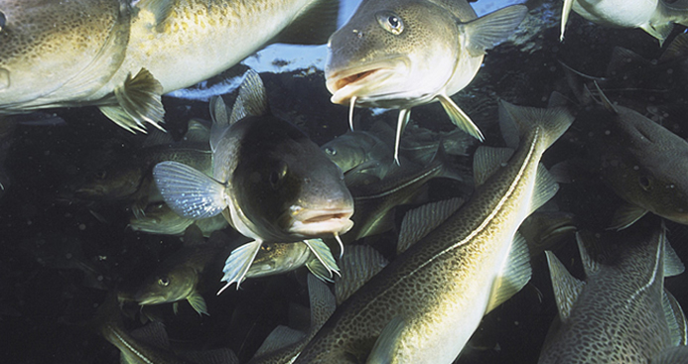
Marine life – our common responsibility
Thank you for your attention

